Slide 1


SAP S/4HANA CDS, BTP Full Stack Training Day 10
Anubhav Oberoy

Slide 2

Day 10
Setting Default value - augment
Adding Actions
Provide determinations
Authorizations
---break
Analytic use case
Developing the Analytic Interface Views
Developing Consumption Views
Expose Service
--break
Create Analytic List Report Application
Notes:
https://unsplash.com/photos/CPs2X8JYmS8

Slide 3

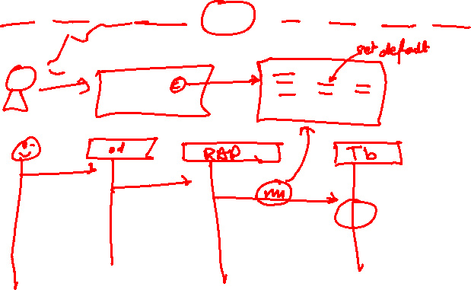
Augment
Augmentation is added in the projection layer such that you can add data or modify incoming requests in the projection layer before the request reaches to the RAP business object so, in your case as you have augment defined at the create operation, once you send the request for Create operation then the augment implementation defined at the projection BDEF will be triggered.
Requirement:
Set the default value of travel request to Open when a new BO instance is created
www.anubhavtrainings.com

Slide 4

Actions
In the RAP context, an action is a non-standard operation that change the data of a BO instance. They are self-implemented operations. Two main categories of actions can be implemented in RAP:
Non-factory actions: Defines a RAP action which offers non-standard behavior. The custom logic must be implemented in the RAP handler method FOR MODIFY. An action per default relates to a RAP BO entity instance and changes the state of the instance. An action is related to an instance by default. If the optional keyword static is used, the action is defined as static action. Static actions are not bound to any instance of a RAP BO entity but relate to the complete entity.
Factory actions: Factory actions are used to create RAP BO entity instances. Factory actions can be instance-bound (default) or static. Instance-bound factory actions can copy specific values of an instance. Static factory actions can be used to create instances with prefilled default values.
Actions are specified as non-standard operations in behavior definitions by using the following syntax:
```
[implementation] managed;
define behavior for CDSEntity [alias AliasedEntityName]
implementation in class ABAP_ClASS_NAME [unique]
...
{
[static] [factory] [internal] action ActionName
[parameter {InputParameterEntity | $self)} ]
[result [cardinality] {OutputParameterEntity | $self}];
...
}
```

Slide 5
Feature Control
As an application developer you may want to determine, which entities of your business object should be create-, delete- and update-enabled, so that they can be modified during consumption using EML or OData services. In addition, you also may want control which (UI) fields of an entity are read-only or which actions in which usage scenarios are enabled or disabled for execution by the end users.
In ABAP RESTful programming model, the feature control is precisely the means of accomplishing such tasks. It allows you to control the visibility and changeability of fields, operations or entire entities.
Depending on whether feature control refers to specific instances or is independent of each entity instance, we distinguish between `instance-bound` and `static feature control`.
The availability of feature control values is modelled in a behavior definition. Unlike static, instance-bound feature control requires not only a definition but also an implementation in a handler class of the behavior pool. Therefore, we also talk about `dynamic feature control` in case of instance-bound feature control.
/* or (instance-based) dynamic operation control: implementation required! */
create (features: instance);
update (features: instance);
delete (features: instance);
/* (2) Feature control at field level */
/* Static field control */
field (read only | mandatory) f1[, f2, ..., fn];
/* or dynamic field control: implementation required! */
field (features: instance) f1[, f2, ..., fn];
/* (3) Feature control for actions */
/* Static action control */
internal action ActionName [...]
/* or dynamic action control: implementation required! */
action ( features: instance ) ActionName [... ]
}
```
Both, static and dynamic feature control is defined for different levels (entity, field, or action level) in the behavior definition by using the following syntax:
```
[implementation] managed;
define behavior for CDSEntity [alias AliasName]
implementation in class ABAP_ClASS [unique]
...
{
/* (1) Feature control at entity level */
/* Static operation control*/
internal create
internal update
internal delete
www.anubhavtrainings.com

Slide 6
Determination
A determination is an implicitly executed function that handles side effects of modified entity instances. It is invoked by the business object’s framework as soon as a determination’s trigger condition at a predefined point in time, the determination time, is fulfilled.
Determinations are triggered internally based on changes made to the entity instance of a business object. The trigger conditions are checked by business object framework at different points during the transaction cycle, depending on the determination time and the changing operations on the relevant entity instances. For each determination, it is necessary to specify both the determination time and the changes that form the trigger condition. A trigger condition consists of a list of fields belonging to the same entity the determination is assigned to and the changing operations that include creating or updating entity instances. We call this operations trigger operations.
In case a field is changed (after creation or update), the condition is fulfilled. The framework evaluates the triggering condition of all determinations at certain points in time (determination time). For determinations, this is today either after each modification or during the save phase.
You can use a determination primarily to compute data that is derived from the values of other fields. The determined fields and the determining fields either belong to the same entity or to different entities of a business object.
Determinations are specified for individual business object’s entities in the behavior definition by using the following syntax:
```
[implementation] managed;
define behavior for CDSEntity [alias AliasedName]
implementation in class ABAP_ClASS [unique]
...
{
// (1) determination for triggers at field level
determination DeterminationName on (save | modify) { field f1[, f2, ..., fn] ; }
// (2) determination for triggers at entity level
determination DeterminationName on (save | modify) { create; }
...
}
```
www.anubhavtrainings.com

Slide 7
Authorization
Authorization control in RAP protects your business object against unauthorized access to data. Authorization control is always relevant when the permission to execute an operation depends on the role of the business object consumer. In RAP each read or modify request can be checked via authorization objects against user roles before the request is finally executed and reaches data.
• The authorization check with authorization objects is called from CDS entities in case of read requests And from the behavior implementation in case of modify requests.
Global Authorization
• Global authorization is used for all authorization checks that only depend on the user. <br/>
• Global authorization checks can be implemented for both, static and instance-bound operations.
Instance Authorization
• Instance authorization is used for all authorization checks that, in addition to the user role, depend on the state of the entity instance in question.Instance authorization is only possible for instance-based operations. <br/>
• Operations that are excluded from instance authorization are CREATE and static actions.
www.anubhavtrainings.com

Slide 8
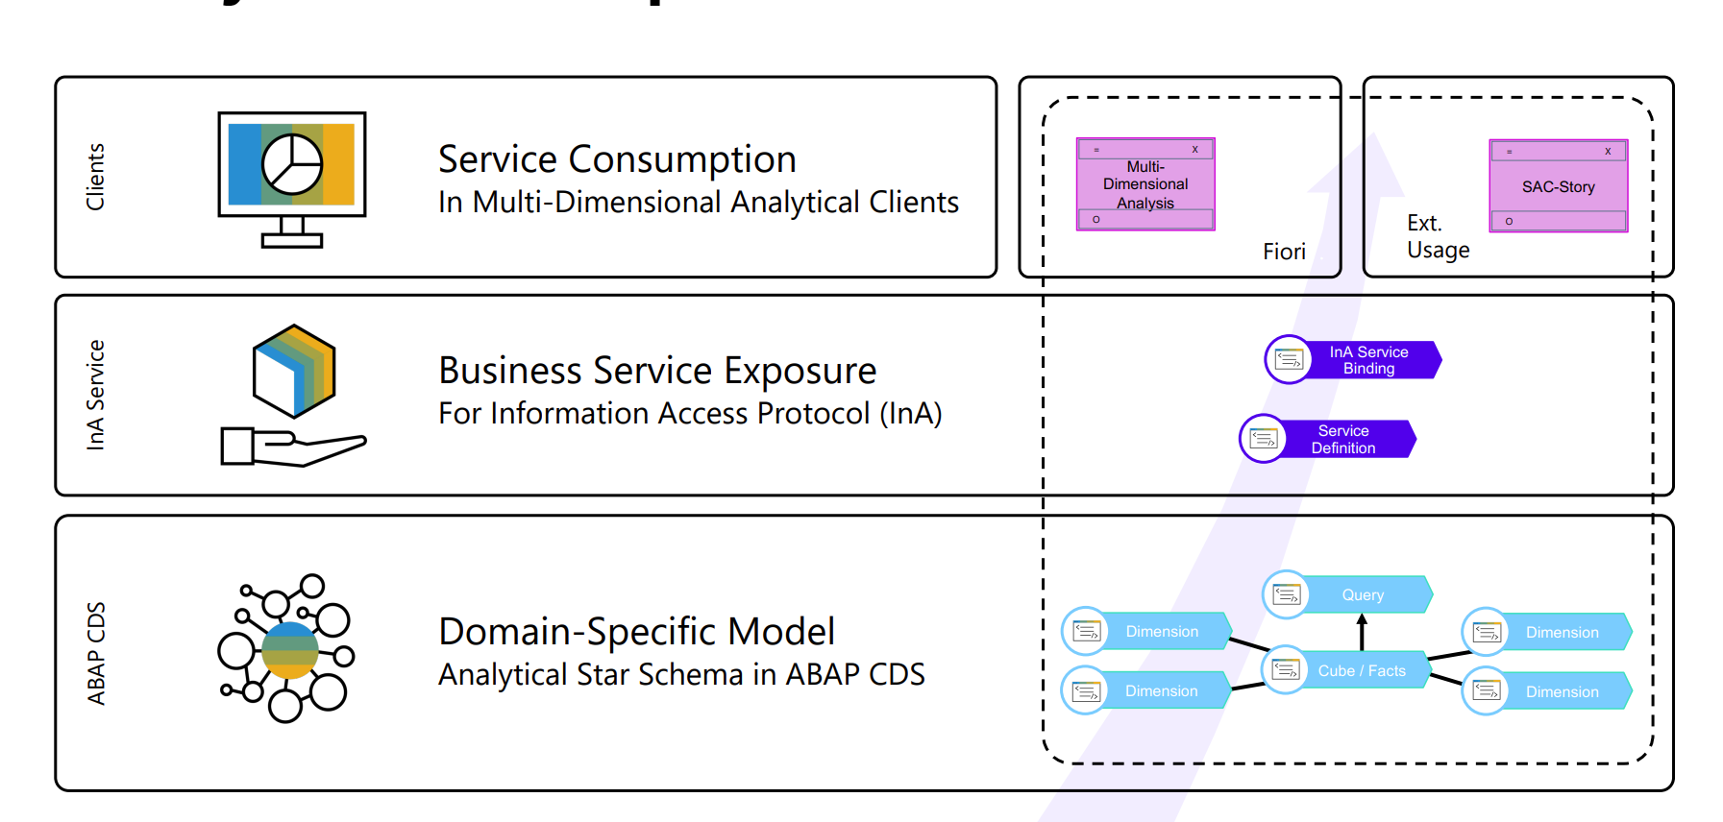
Scope for Analytics Development
content
www.anubhavtrainings.com

Slide 9


































































Title
content
www.anubhavtrainings.com

Slide 11

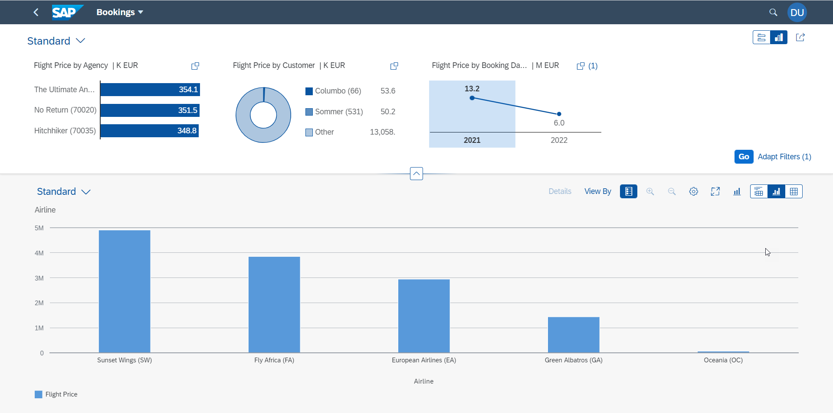















Analytic List Page
A ALP is used to display analytics as well as line item data in list. We can analyze data distribution across multiple dimensions for our measures. It also allows along with filter bar a special types of filter called visual filter.
www.anubhavtrainings.com

Slide 12













































Slide 13

Questions?

Slide 14

Thank you
Anubhav.abap@gmail.com
contact@anubhavtrainings.com
+91 84484 54549
www.anubhavtrainings.com

